Slide 1

Microsoft Azure
Brief Overview and Creation of Test Website
Notes:
introduction

Slide 2

What is Microsoft Azure?

Slide 3
From Official Website
“Azure is Microsoft’s cloud computing platform, a growing collection of integrated services - analytics, computing, database, mobile, networking, storage, and web - for moving faster, achieving more, and saving money.”
http://azure.microsoft.com/
Notes:
Добавить рамку

Slide 4
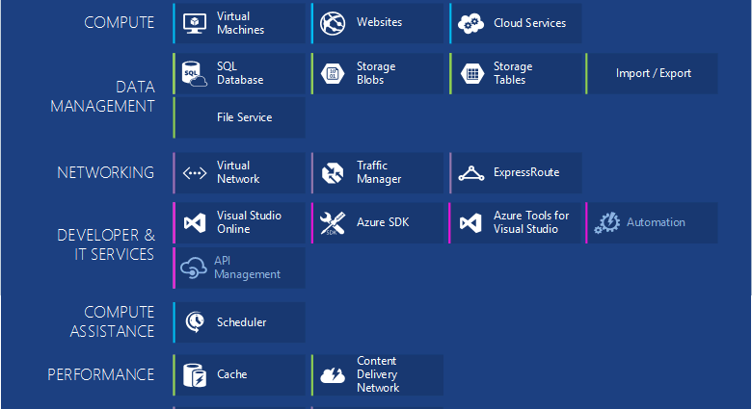
Azure Components
Notes:
https://azure.microsoft.com/en-us/documentation/articles/fundamentals-introduction-to-azure/
Icons:
https://www.amido.com/azure-icons-for-lucidchart/

Slide 5
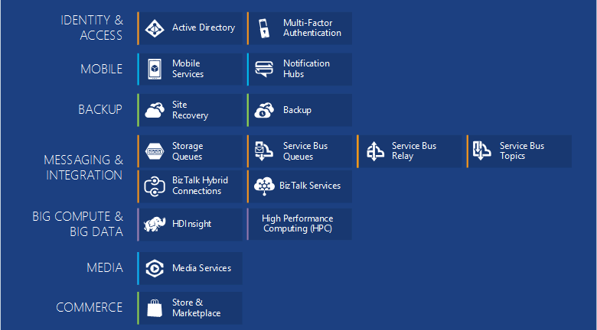
More Azure Components
Notes:
https://azure.microsoft.com/en-us/documentation/articles/fundamentals-introduction-to-azure/

Slide 6






Cloud Solutions
War of Attrition
Notes:
Slides “Windows Azure vs. Amazon AWS”:
http://www.slideshare.net/tekcraft/azure-vsamazon?related=1
https://image.slidesharecdn.com/warofattritioninfographicv1-150103195155-conversion-gate02/95/war-of-attrition-aws-vs-google-ibm-and-microsoft-azure-1-638.jpg?cb=1424632280

Slide 7
Enterprise Public Cloud Usage
Notes:
Information from:
http://assets.rightscale.com/uploads/pdfs/RightScale-2015-State-of-the-Cloud-Report.pdf
http://www.rightscale.com/blog/cloud-industry-insights/cloud-computing-trends-2015-state-cloud-survey
In January 2015, RightScale conducted its fourth annual State of the Cloud Survey of the latest cloud computing trends, with a focus on infrastructure-as-a-service. The survey asked 930 IT professionals about their adoption of cloud infrastructure and related technologies. The respondents ranged from technical executives to managers and practitioners and represented organizations of varying sizes across many industries. The margin of error is 3.2 percent.

Slide 8
2014 Statistics
Notes:
https://image.slidesharecdn.com/warofattritioninfographicv1-150103195155-conversion-gate02/95/war-of-attrition-aws-vs-google-ibm-and-microsoft-azure-1-638.jpg?cb=1424632280
DEFINITION of 'Free Cash Flow - FCF'
A measure of financial performance calculated as operating cash flow minus capital expenditures. Free cash flow (FCF) represents the cash that a company is able to generate after laying out the money required to maintain or expand its asset base. Free cash flow is important because it allows a company to pursue opportunities that enhance shareholder value. Without cash, it's tough to develop new products, make acquisitions, pay dividends and reduce debt. FCF is calculated as:EBIT(1-Tax Rate) + Depreciation & Amortization - Change in Net Working Capital - Capital ExpenditureIt can also be calculated by taking operating cash flow and subtracting capital expenditures.
Read more: http://www.investopedia.com/terms/f/freecashflow.asp#ixzz3crRZ0U2k Follow us: @Investopedia on Twitter

Slide 9
Payments
Notes:
App Service Pricing:
http://azure.microsoft.com/en-us/pricing/details/app-service/

Slide 10

Azure Geography
Azure operates out of 17 regions around the world
Notes:
http://azure.microsoft.co
AZURE REGION LOCATION
Central US Iowa
East US Virginia
East US 2 Virginia
US Gov Iowa Iowa
US Gov Virginia Virginia
North Central US Illinois
South Central US Texas
West US California
North Europe Ireland
West Europe Netherlands
East Asia Hong Kong
Southeast Asia Singapore
Japan East Tokyo, Saitama
Japan West Osaka
Brazil South Sao Paulo State
Australia East New South Wales
Australia Southeast Victoriam/en-us/regions/

Slide 11
Cloud Service Models
Managed by Customer
Managed by Vendor
Private
(On-Premises)
Infrastructure
(as a Service)
Platform
(as a Service)
Software
(as a Service)
Applications
Applications
Applications
Applications
Data
Data
Data
Data
Runtime
Runtime
Runtime
Runtime
Middleware
Middleware
Middleware
Middleware
O/S
O/S
O/S
O/S
Virtualization
Virtualization
Virtualization
Virtualization
Server
Server
Server
Server
Storage
Storage
Storage
Storage
Networking
Networking
Networking
Networking
Notes:
Windows Azure IaaS vs. PaaS vs. SaaS
http://robertgreiner.com/2014/03/windows-azure-iaas-paas-saas-overview/
Which Windows Azure Cloud Architecture? PaaS or IaaS ?
http://blogs.msdn.com/b/hanuk/archive/2013/12/03/which-windows-azure-cloud-architecture-paas-or-iaas.aspx

Slide 12

Cloud Service Models and Azure
IaaS
Virtual Machines
SaaS
PaaS
Cloud Services
SQL Azure
Storage Tables
Storage Blobs
Cache
Traffic Manager
Mobile Services
Notes:
Windows Azure IaaS vs. PaaS vs. SaaS
http://robertgreiner.com/2014/03/windows-azure-iaas-paas-saas-overview/
IaaS: VM
PaaS: CloudServices, WebSites, SQL Azure
SaaS: WebSites (Drupal, Jumla), SharePoint,
Icons:
https://www.amido.com/azure-icons-for-lucidchart/

Slide 13
Azure IaaS vs PaaS Statistics

Slide 14

From Words to Deeds
Notes:
https://portal.azure.com
https://manage.windowsazure.com

Slide 15
How to Try (Free Trial)

Slide 16
How to Manage
From Visual Studio with Azure SDK
From Management Portals:
https://manage.windowsazure.com
https://portal.azure.com (beta)
Using PowerShell Console
Notes:
How to install and configure Azure PowerShell:
https://azure.microsoft.com/en-us/documentation/articles/powershell-install-configure/

Slide 17
Azure SDK and Command-line Tools
The Azure SDK for .NET is the core building block that helps developers author Cloud Services using Azure Service Runtime Programming model, debug using emulators on the local machine, and deploy to Azure data centers in the cloud.
The Azure SDK Policy covers Azure SDK Authoring Tools, Command line utilities, Compute & Storage Emulators, and Azure Tools for Microsoft Visual Studio.
Notes:
Downloads:
http://azure.microsoft.com/en-us/downloads/
Main data from:
https://msdn.microsoft.com/en-us/library/azure/dn479282.aspx
How to install and configure Azure PowerShell
https://azure.microsoft.com/en-us/documentation/articles/powershell-install-configure/

Slide 18
App Service (Web App)

Slide 19
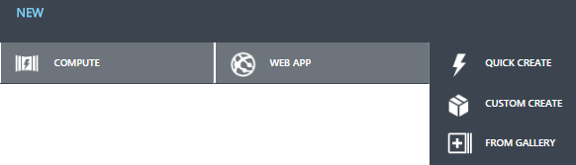

Create App Service
Screenshot
From Management Portals
From Visual Studio Interface
Using PowerShell Console
Screenshot
Notes:
How could be created?

Slide 20
Create App Service from PowerShell
Code Snippet
$AzureSubscriptionId = Some_Azure_Subscription_Id "
Import-AzurePublishSettingsFile “**\*.publishsettings"
Set-AzureSubscription –SubscriptionId $ AzureSubscriptionId
$AzureTestWebSite = "workshop-created-from-ps"
New-AzureWebsite $ AzureTestWebSite
Get-AzureWebsite -Name $ AzureTestWebSite
Stop-AzureWebsite -Name $ AzureTestWebSite
Get-AzureWebsite -Name $ AzureTestWebSite
Remove-AzureWebsite -Name $ AzureTestWebSite
Get-AzureWebsite
CreateWebSite.ps1
Notes:
How to install and configure Azure PowerShell
https://azure.microsoft.com/en-us/documentation/articles/powershell-install-configure/
Clear-AzureProfile before the Add-AzureAccount
http://blogs.msdn.com/b/devfish/archive/2015/02/12/get-azurevm-your-azure-credentials-have-not-been-set-up-or-have-expired-please-run-add-azureaccount-to-set-up-your-azure-credentials.aspx

Slide 21
Deploy a Web App
Deploy from a cloud-hosted source control system
Deploying from an IDE
Deploy using an FTP utility
Deploying from an on-premises source control system
Deploy using command-line tools and the Azure REST management API
Octopus Deploy
Notes:
Deploy a web app in Azure App Service
https://azure.microsoft.com/en-us/documentation/articles/web-sites-deploy/

Slide 22

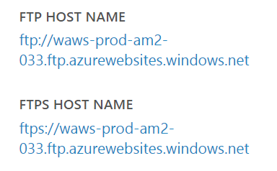
FTP Access
Just create FTP credentials and use provided on Management Portal access points
Screenshots

Slide 23
Secure a web app in Azure App Service
Notes:
Secure a web app in Azure App Service
https://azure.microsoft.com/en-us/documentation/articles/web-sites-security/

Slide 24
Pricing Tiers

Slide 25
SQL DAtabases

Slide 26
Create Database
DATABASE THROUGHPUT UNITS
Notes:
Database Throughput Unit (DTU):
DTUs provide a way to describe the relative capacity of a performance level of Basic, Standard, and Premium databases. DTUs are based on a blended measure of CPU, memory, reads, and writes. As DTUs increase, the power offered by the performance level increases. For example, a performance level with 5 DTUs has five times more power than a performance level with 1 DTU. A maximum DTU quota applies to each server. For more information on DTU quotas, seeAzure SQL Database General Guidelines and Limitations.
DTUs provide a way to describe the relative capacity of a performance level based on a blended measure of CPU, memory, reads, and writes. Each server has a maximum of 2000 DTUs for Basic, Standard, and Premium databases, in addition to the overall limit for databases per server and maximum size per database. DTUs are consumed based on the DTU rating for that performance level. For example, a server with 5 Basic databases, 2 Standard S1 databases, and 3 Premium P1 databases consumes 365 DTUs. For more information on the DTU rating associated with each performance level, see Azure SQL Database Service Tiers and Performance Levels. An extension of this DTU quota may be available for your Azure SQL Database server. For more information, contact Azure Support.
Azure SQL Database Service Tiers and Performance Levels (Grid with details)
https://msdn.microsoft.com/en-us/library/azure/dn741336.aspx
Nice link with details about tiers:
https://azure.microsoft.com/en-us/documentation/articles/sql-database-upgrade-new-service-tiers/

Slide 27
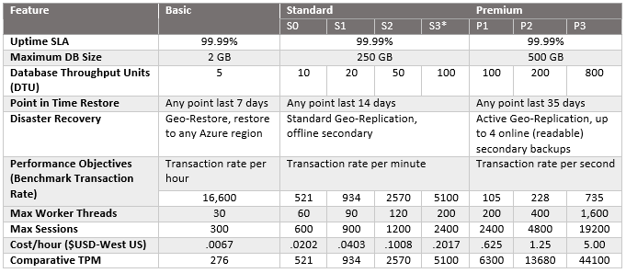
Databases Tiers
Notes:
From:
https://azure.microsoft.com/en-us/documentation/articles/sql-database-upgrade-new-service-tiers/

Slide 28
Storage

Slide 30
Tiered Migrations
Take Advantage of PaaS Where You Can
Many Applications could benefit from migrating to a mixed deployment. Migrating to web/worker roles or taking advantage of other Windows Azure services (storage, cache etc..)
Benefits of Web and Worker Roles
Simplified Deployment and Configuration
Health Model
Easy High Availability
Instance Scalability
OS Patching
Automatic Firewall Configuration
Simple Certificate Deployment
Many others

Slide 31


